Slide 1
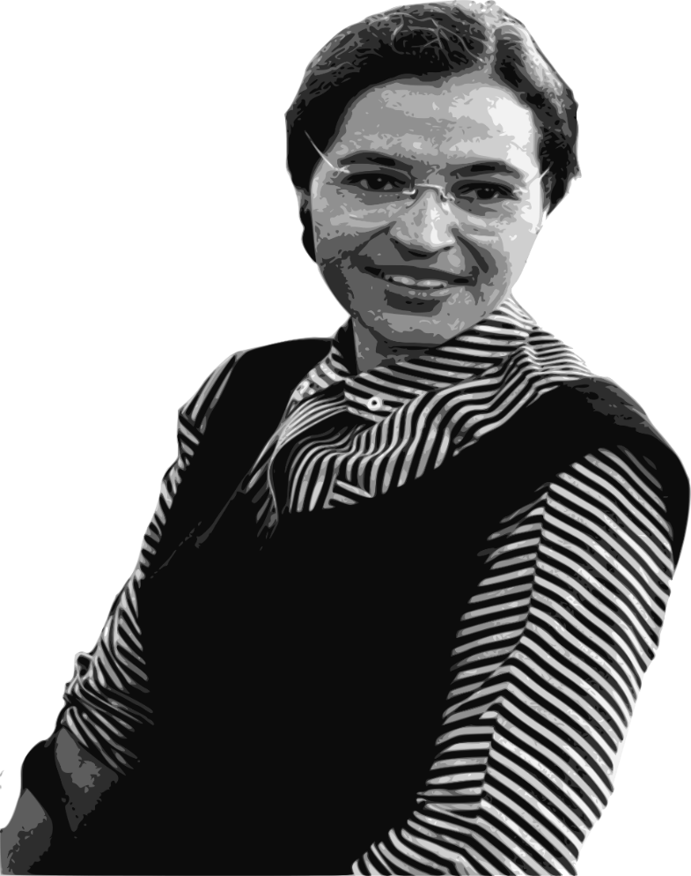
ROSA PARKS

Slide 2
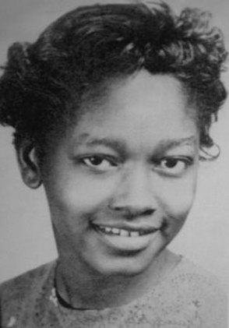
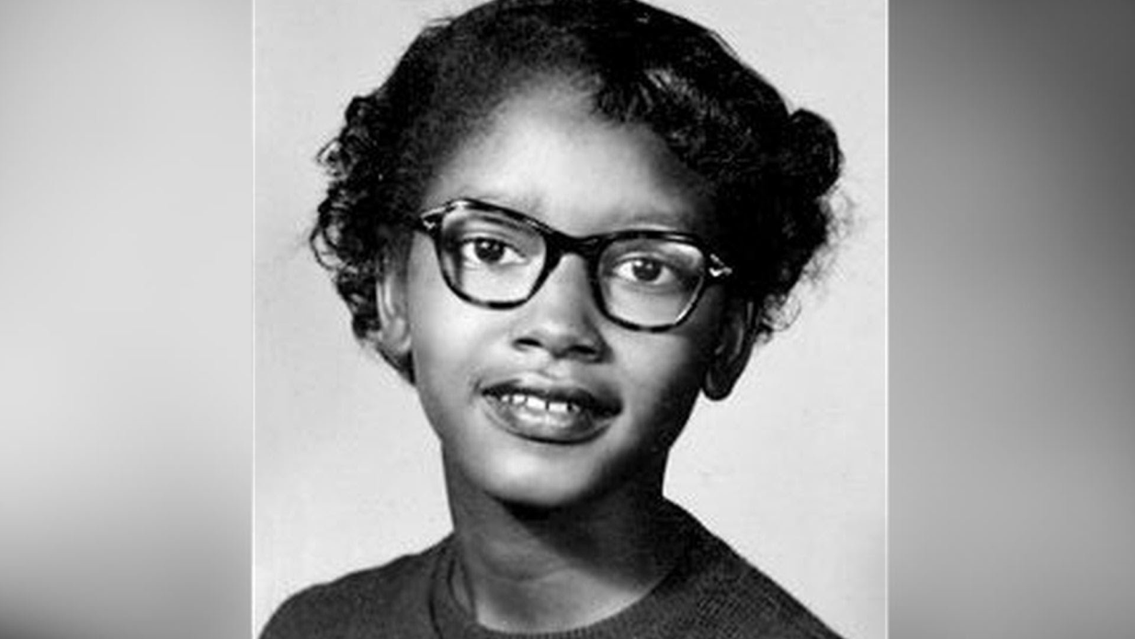
when was she born
Rosa Louise McCauley
February 4, 1913
Tuskegee, Alabama, U.S.

Slide 3
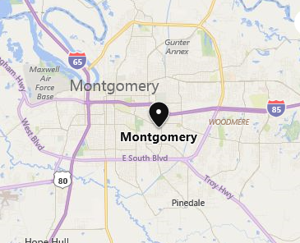
THE REAL NAME WAS ROSA LOUISE MCCAULY
AFRICAN-AMERICAN CIVIL RIGHTS ACTIVIST
PARKS IS BEST KNOWN FOR WHAT SHE DID IN HER HOME TOWN OF MONTGOMERY, ALABAMA ON DECEMBER 1, 1955.

Slide 4
ACCIDENT
WHILE SHE SAT IN A SEAT IN THE MIDDLE OF THE BUS, THE BUS DRIVER TOLD HER TO MOVE TO THE BACK OF THE BUS.
SO A WHITE PASSENGER COULD TAKE THE SEAT IN THE FRONT OF THE BUS. DURING THIS TIME, WHEN THERE WERE NO WHITE SEATS FOR WHITE PEOPLE, BLACK PEOPLE WERE TOLD TO GET UP OUT OF THEIR SEAT.

Slide 5
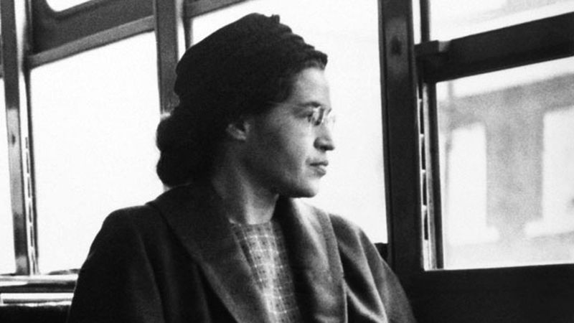
PARKS REFUSED TO MOVE. SHE WAS A MEMBER OF THE NATIONAL ASSOCIATION FOR THE ADVANCEMENT OF COLORED PEOPLE (NAACP). LIKE SO MANY OTHERS SHE WAS TIRED OF BEING TREATED AS A LOWER CLASS PERSON BECAUSE OF THE COLOR OF HER SKIN.

Slide 6
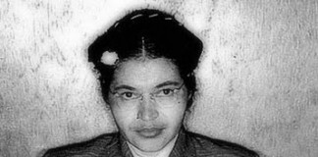
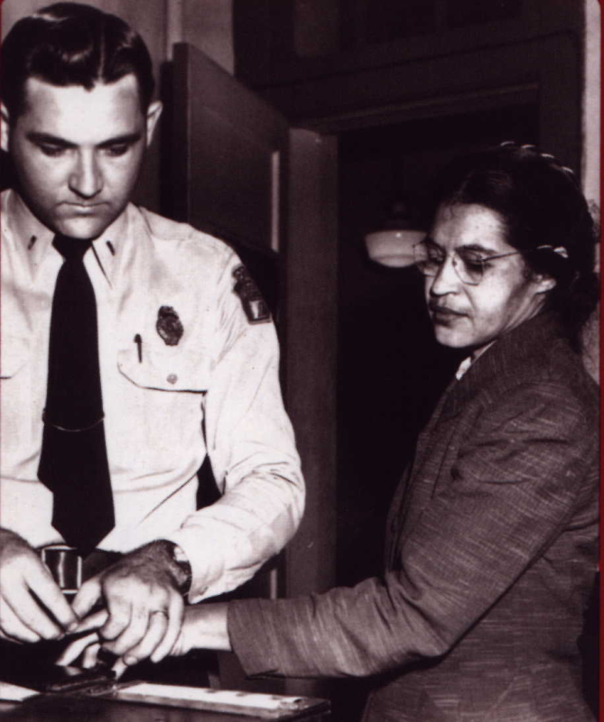
WHEN ROSA PARKS WENT TO JAIL
SHE WAS 381 DAYS IN JAIL.
PARKS BEING FINGERPRINTED
AFTER HER ARREST

Slide 7
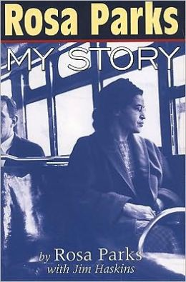
SHE WROTE 2 BOOKS

Slide 8
Rosa Parks married
Raymond Parks

Slide 9
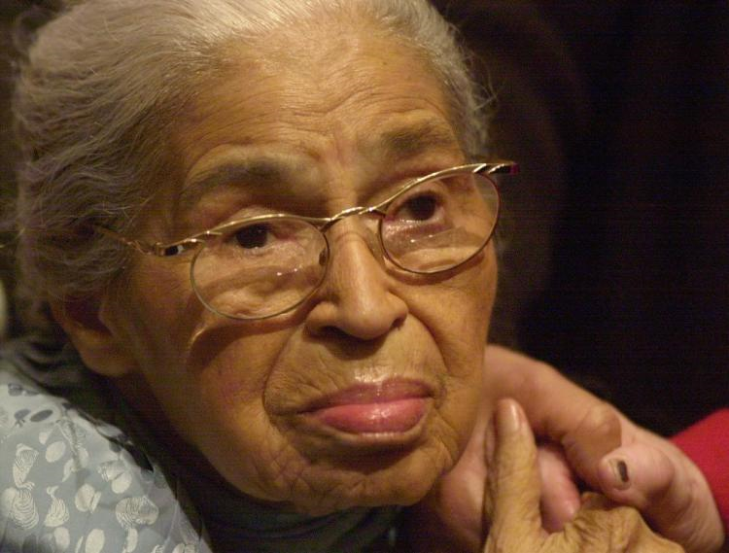
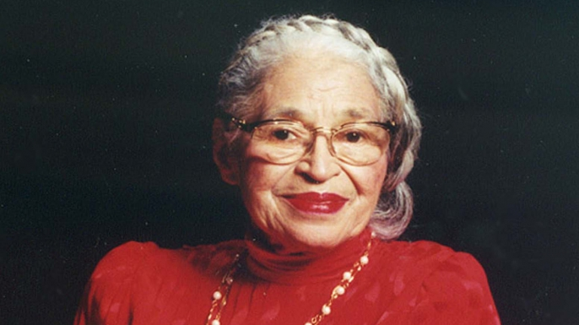
WHEN ROSA PARKS DIED
SHE DIED ON OCTOBER 24, 2005 (AGED 92)
DETROIT, MICHIGAN. U.S.

Slide 10
THANK YOU FOR WATCHING

